Slide 1

Understanding Spark Streaming

Slide 2
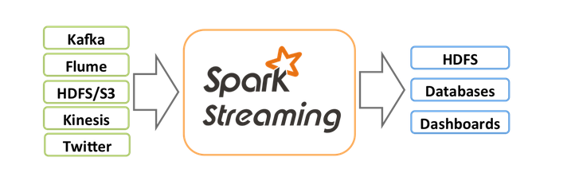
Spark Streaming
Second Scale Latency
Scalable
Fault Tolerent
Once and only once processing
Can merge RDD with Dstreams
Use Spark SQL, ML libraries etc

Slide 3
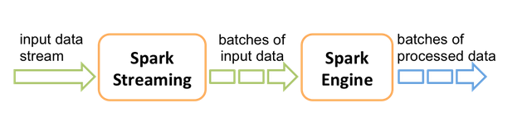
Micro Batch vs. Streaming
Spark “chunks” input streams into batches of data.
The batch is called as Dstream (Which is a sequence of RDD)

Slide 4

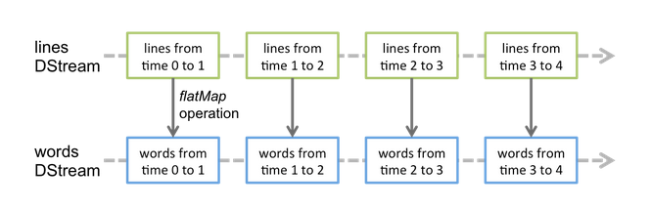
Network Wordcount Example

Slide 5
Spark Streaming - API
The concept of Listeners
The concept of Dstream
Checkpointing
Statefulness of Dstreams
Sliding Window (Time slicing)
Checkpoint

Slide 6
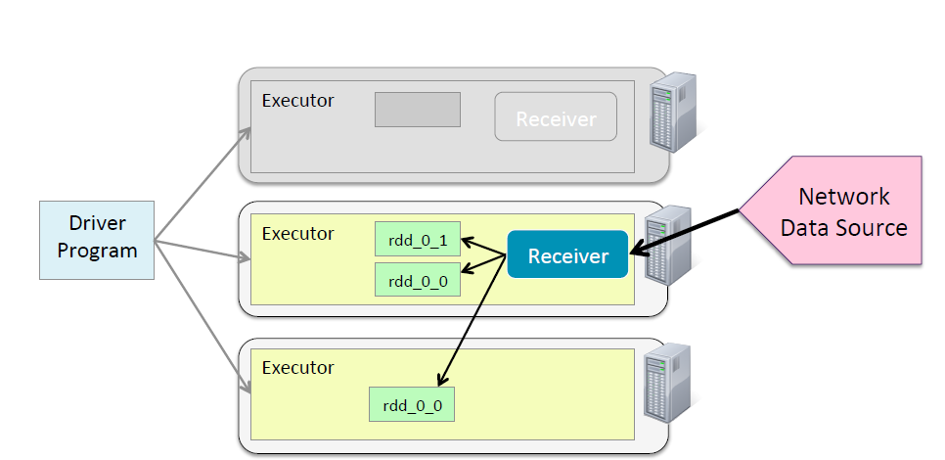
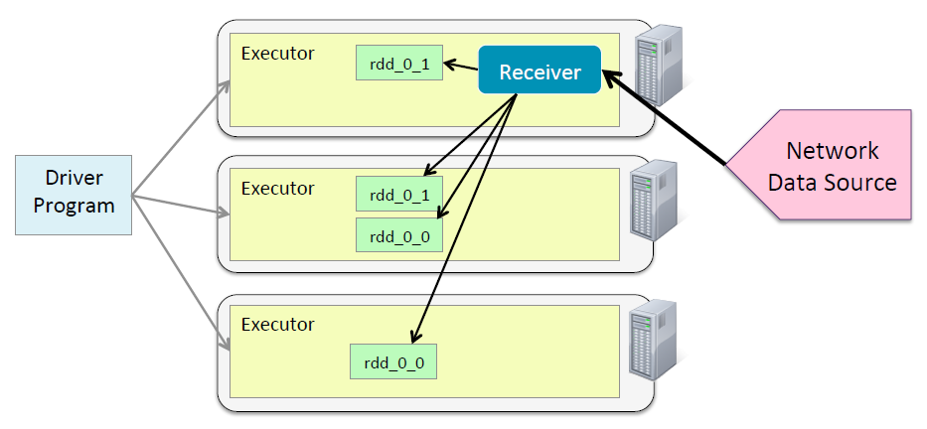
Input Streams – Fault Tolerence

Slide 7
DStreams
File Streams allows Spark Streaming to listen to changes to FS (HDFS, local FS, NFS etc)
The generic format is:
streamingContext.fileStream[KeyClass, ValueClass, InputFormatClass](dataDirectory)
For advanced source such as Flume, KAFKA etc, a linking process is required.
Ex: spark-streaming-wordcount.scala
Ex: Streaming Log.scala
Python/streamtest.py localhost 4444 10 \
/user/hgfs/f/data/Hive and Spark/weblogs

Slide 8
Using Dataframes with Streaming
Ex: /mnt/hgfs/f/code/spark-streaming/spark-streaming-df-wordcount.scala
<Attribution: Spark Example from Git Hub>

Slide 9
Twitter Stream & Sentiment Analysis
Setup your Twitter Developer Account
http://docs.aws.amazon.com/gettingstarted/latest/emr/getting-started-emr-sentiment-create-twitter-account.html
Sentiment Analysis: https://class.coursera.org/nlp/lecture/145
Ex: spark-streaming-twitter.scala
spark-streaming-twitter-movies.scala
spark-streaming-sentiment-analysis2.scala
Data: sentiment_dictionary.csv

Slide 10
Checkpointing
Metadata Check pointing
Stores information that would be required to recover from a potential crash
Data check point
When Stateful Dstreams are used
Checkpoint interval = 10 sec (default)
dstream.checkpoint(checkpointInterval)
Checkpoint interval = 5-10x of Dstream interval
Dual use of checkpoint directory:
val context = StreamingContext.getOrCreate(checkpointDirectory, functionToCreateContext _)
ssc.checkpoint(checkpointDirectory)
Qn: Why checkpointing when RDD lineage is enough?
Ex: spark-streaming-wc-checkpoint.scala

Slide 11
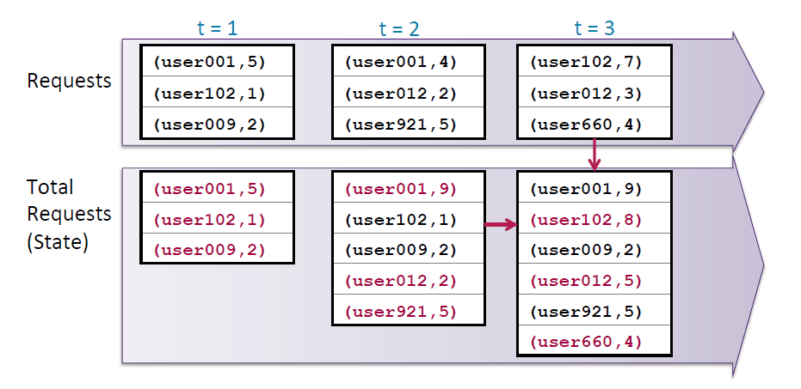
Group By users over time – what is different with this RDD?
Designate recovery point: check pointing
1
Stateful = When data is combined from multiple batches
Update Values
Update Values
2
3

Slide 12
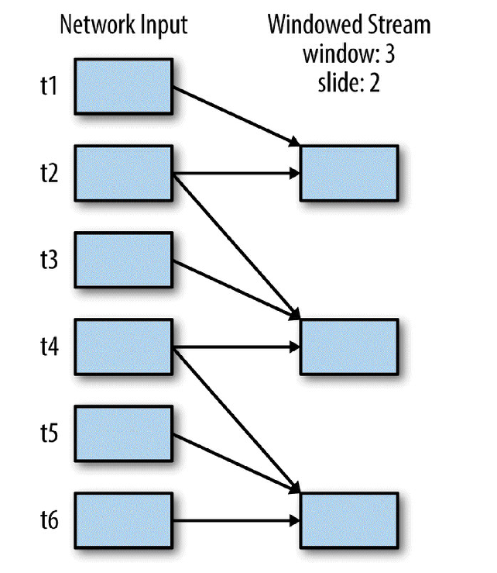
The concept of Sliding Window
Windows provide a mechanism to combine data across batches
3 types of “time”
Batch duration (specified in SSC) – Say 10 seconds
Window Duration (say 5 min) - Treat it more like a length of the window
Sliding Duration (say 30 seconds) (default = same as batch duration)
Qn: How many batches (RDDs) are there in the window?
5 min / 10 second = 30 batches

Slide 13
Time in Spark Streaming
Batch Duration
Impacts the Listener
Specifies how often do you want spark to “collect” data
Window Duration
Specifies how “large” is your in - memory processing data set.
Sliding Duration
How often do you want to run your computation
Typically, some multiple of batch duration
Ex: Windowed-count.scala

Slide 14
Window Operations
2 Types of window operation:
UpdateStateByKey() – The update function
val totalUserReqs = userreqs.updateStateByKey (updateCount)
Window Operations
ReduceByWindow & ReduceByKeyAndWindow(fn, time 1, time2)
countByWindow & countByKeyAndWindow

Slide 15
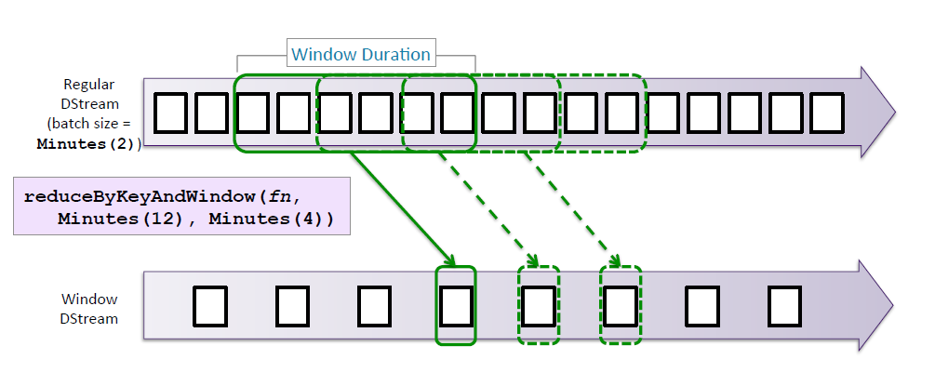
Window Operation

Slide 16
Summary
Spark Streaming is an API on top of Spark Core
Various listeners are available that can listen to Spark sources
Directory & Socket Listeners built in
Twitter, Flume, KAFKA etc available as add-on
Dstreams is a supercollection of RDDs
Possible to perform many transformations such as count(), filter etc on Dstreams
Checkpoint Dstreams to avoid its infinite growth
Dstreams can be manipulated with RDDs and Data Frames
Manipulate Dstream “States”
Eg. Update “Total” requests by users
Timeslice Dstreams into Windows
Perform operations on windows (rather than on the full Dstreams)
Eg.# of logins in the last 30 minutes.

